Slide 1
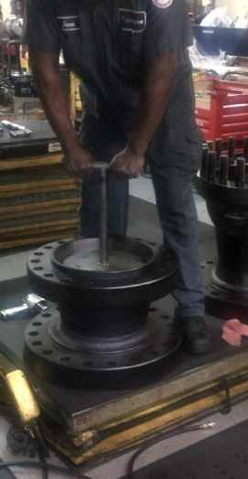
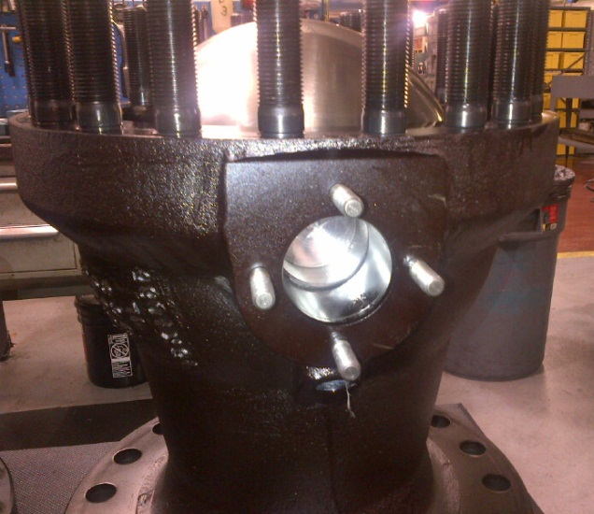
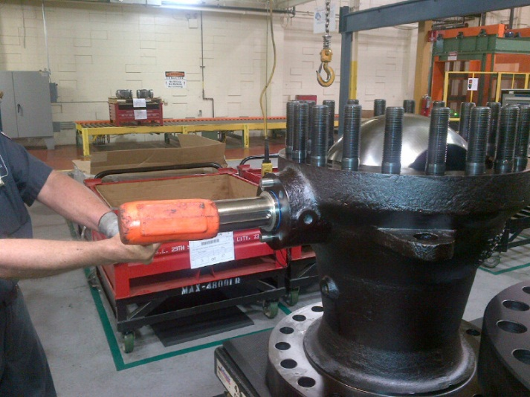
Seat Assembly – Current Method
Current method of installing seats:
Not ergonomic; operator has to manually drive the seats in with heavy tooling
Potential for damaging seats
Makes installation of trunnions difficult because seat is lifting ball up
Trunnion hole not lined up
Trunnions have to be driven in with deadblow

Slide 2
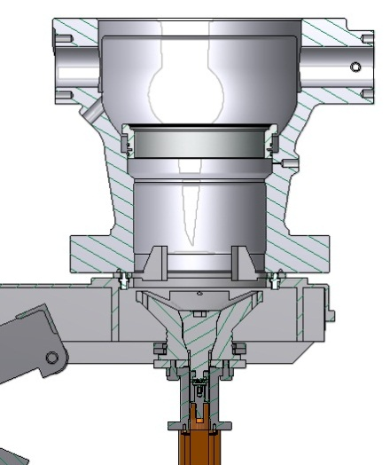
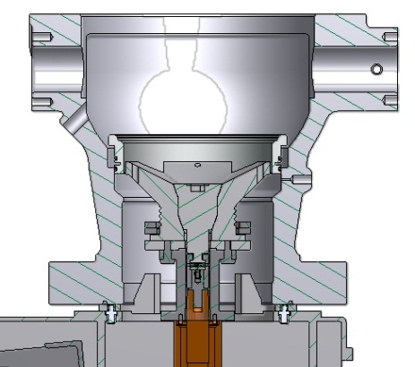
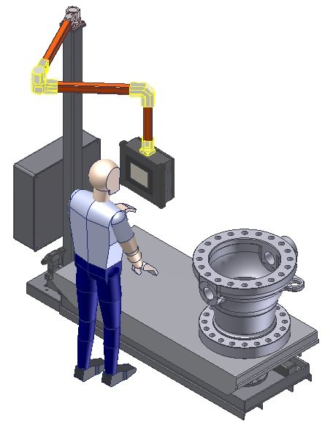
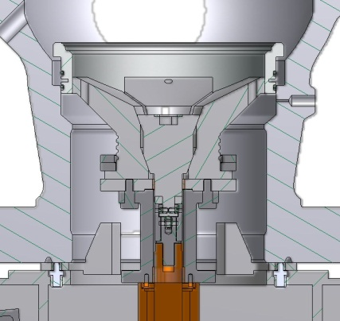
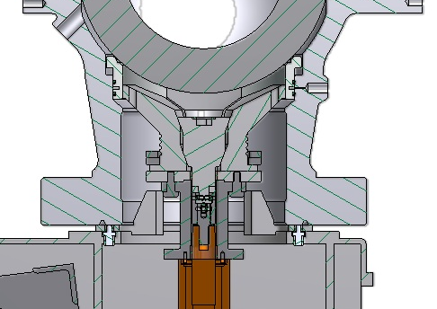
Seat Installer
1. Place seat
2. Lower table. Table will
automatically stop at
correct position
3. Expand mandrel to
grip seat
4. Raise table to install seat.
Table will automatically
stop at correct position.
Automated seat installer provides the following benefits:
More ergonomic; eliminates manual installation
Consistent, repeatable installation
Makes ball and trunnion installation easier by taking up spring pressure
Reduces opportunity for defects
5. Finish assembly of ball and
trunnions, then release
mandrel

